Slide 1
Interpretability Framework - Motivation
Brings together existing and new interpretability techniques alongside datasets and machine learning models.
Simplifies experimentation and data generation
Allows the sharing and testing of ideas across the research team reducing repeated work and setup time.
PICTURE OF UI

Slide 2
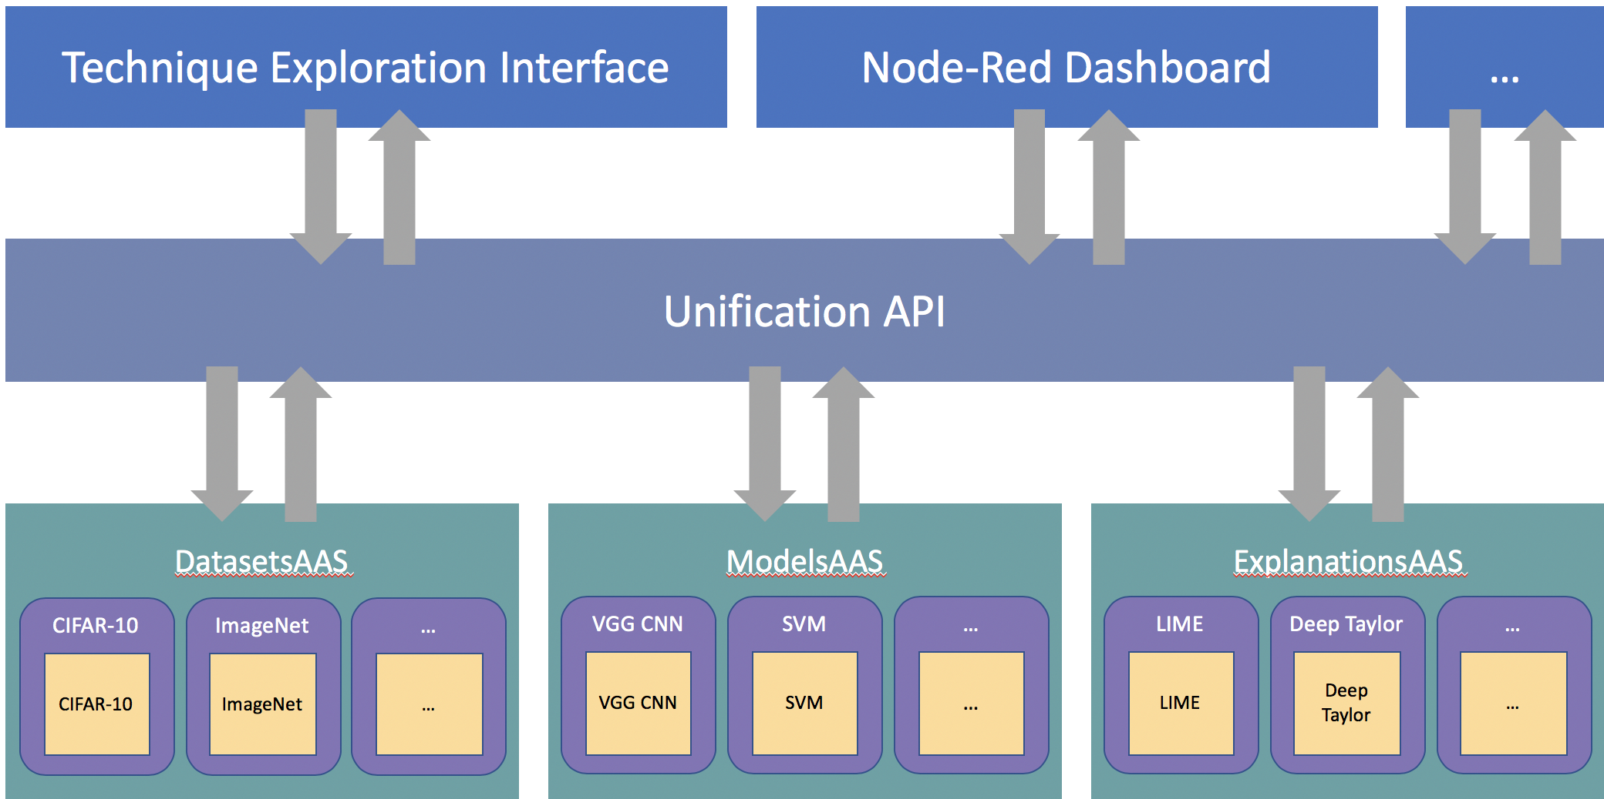
Interpretability Framework - Architecture
Interface Layer Decoupled user interfaces
Unification Layer API offering easy access to framework items.
Service Layer Services for each category coordinate instantiation and data passing.
Class & Implementations Layer Classes wrap around implementations of items maximizing interconnectivity.

Slide 3
Interpretability Framework - Example Use Cases
Compare the outputs of multiple interpretability technique when processing the same model and input to evaluate their strengths & weaknesses.
Compare multiple outputs generated by a single interpretability technique for the same input to evaluate the techniques stability.
Compare outputs from a single interpretability technique when using different models (e.g. architecture, training, algorithm) to evaluate how the technique’s effectiveness depends on the model.

Slide 4


Interpretability Framework – Current & Future Work
Comparative/sensitivity analyses of explanation techniques - we demonstrated the debugging process of generating multiple explanations from the same technique to measure and improve its stability.
Empirical studies of explanation visualisations – exploration of the effect the choices made for visualising explanation data can effect it’s utility.
Eliciting stakeholder requirements for application-level interpretability – engaging with subject-matter experts to gain insights as to what constitutes a useful explanation for aiding task performance.

